Slide 1
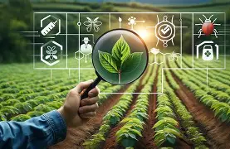
Smart Crop Health & Pest-Risk Monitoring System
An IoT-Based Solution
Presented by: GreenTech

Slide 2
INTRODUCTION
Crop losses due to pests and poor monitoring remain high in South Africa
Smart farming adoption is low despite proven benefits
The smart crop health and pest risk monitoring system proposes an IoT and AI workflow for real-time crop health insights.

Slide 3
AIM & MISSION
Aim
Design a system to monitor crop health and detect pest risks early.
Mission
Improve productivity through data-driven decisions
Reduce losses
Support digital agriculture adoption

Slide 4
PROPOSED SOLUTION
Arduino + sensors (soil moisture, temperature, LED, IR Sensor) on Proteus
Blender 3D crop-field model

Slide 5
CHALLENGES
Connectivity issues linking Proteus → Blender → Data Platform
Sensor calibration needed for accuracy
Difficulty Integrating Sensors in Proteus
Data Logging Issues on Power BI
Designing the 3D Blender Model

Slide 6
WAY FORWARD
Improve Connectivity Between Proteus → Blender → Data Platform
Enhance Blender 3D Modelling Workflow
Integrate AI pest image recognition
Expand the Data Analytics Platform such as the use of Power BI / Google Data Studio for dashboards.

Slide 7
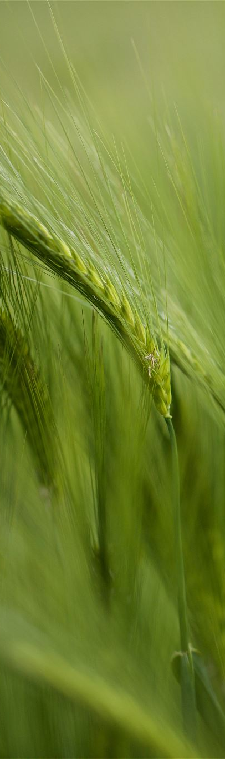
CONCLUSION
The smart crop health and pest risk monitoring system project successfully demonstrates how IoT, simulation, and data analytics can support smart crop monitoring.
The system provides a strong foundation for improving early detection and decision-making.
With further refinement and integration, this solution can enhance agricultural efficiency and promote sustainable smart farming practices.

Slide 8

THANK YOU

